Slide 1
eXTENDED-ER (EER) Model Concepts

Slide 2
Enhanced-ER (EER) Model Concepts
Basic ER diagram + more concepts =EER model
Additional concepts:
Subclasses/superclasses
Specialization/generalization
Categories
Inheritance
Model applications more completely and accurately
Includes Object-oriented concepts s.a inheritance

Slide 3
Subclasses and Superclasses (1)
An entity type may have additional meaningful subgroupings of its entities
EMPLOYEE
Secretary
Engineer
Manager
Technician
Salaried_employee
Hourly_employee
SECRETARY IS-A EMPLOYEE
Superclass
Subclasses

Slide 4
Subclasses and Superclasses (2)
These are also called IS-A relationships (SECRETARY IS-A EMPLOYEE, TECHNICIAN IS-A EMPLOYEE, …).
Note: An entity that is member of a subclass represents the same real-world entity as some member of the superclass
The Subclass member is the same entity in a distinct specific role
A member of the superclass can be optionally included as a member of any number of its subclasses
Example: A salaried employee who is also an engineer belongs to the two subclasses ENGINEER and SALARIED_EMPLOYEE
It is not necessary that every entity in a superclass be a member of some subclass

Slide 5
Attribute Inheritance in Superclass / Subclass Relationships
Member of a subclass inherits all attributes of superclass
It also inherits all relationships

Slide 6
Specialization
Process of defining a set of subclasses of a superclass based upon some distinguishing characteristics of the entities in the superclass
Example:
Job Type - {SECRETARY, ENGINEER, TECHNICIAN}
Payment method- {SALARIED_EMPLOYEE, HOURLY_EMPLOYEE}
Attributes of a subclass are called specific attributes. For example, TypingSpeed of SECRETARY
The subclass can participate in specific relationship types. For example, BELONGS_TO of HOURLY_EMPLOYEE

Slide 7
Generalization
Reverse of the specialization process
Several classes with common features are generalized into a superclass; original classes become its subclasses
We can view {CAR, TRUCK} as a specialization of VEHICLE
Alternatively, we can view VEHICLE as a generalization of CAR and TRUCK
Vehicle
Vehicle
Car
Truck
Car
Truck
Arrows pointing to the specialized subclasses represent a specialization
Arrow pointing to the generalized superclass represents a generalization
Note:It is subjective as to which process is more appropriate for a particular situation

Slide 8
GENERALIZATION AND SPECIALIZATION
student
sid
name
Generalization
is A
Specialization
Undergrad
graduate

Slide 9
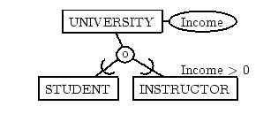
Constraints on Specialization and Generalization (1) – Membership Constraints
Predicate defined constraint-Determine exactly those entities that will become members of each subclass by a condition.
Condition is a constraint that determines subclass members
Display a predicate-defined subclass by writing the predicate condition next to the line attaching the subclass to its superclass

Slide 10
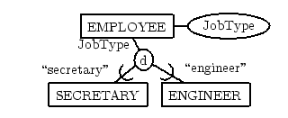
Membership Constraints
Attribute defined-specialization -If all subclasses in a specialization have membership condition on same attribute of the superclass.
Attribute is called the defining attribute of the specialization
Example: JobType is the defining attribute of the specialization {SECRETARY, TECHNICIAN, ENGINEER} of EMPLOYEE

Slide 11
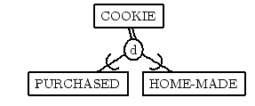
Membership Constraints
User-defined- If no condition determines membership, the subclass is called user-defined
Membership in a subclass is determined at the time of insertion

Slide 12
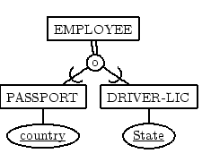
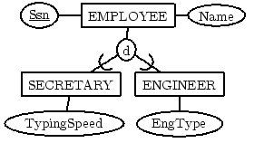
Constraints on Specialization and Generalization (2)- Disjointness Constraints
Disjointness Constraint:
Disjoint (d)The subclasses must have disjoint sets of entities
Overlap (o)The subclasses may have overlapping sets of entities

Slide 13
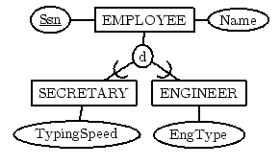
Completeness Constraint:
Partial- An entity may not belong to any of the subclasses (single-line)

Slide 14
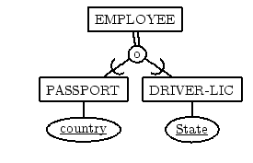
Completeness Constraint:
Total-Every entity in the superclass must be a member of some subclass (double-edge)

Slide 15
Constraints on Specialization and Generalization (3)
Hence, we have four types of specialization/generalization:
Disjoint, total
Disjoint, partial
Overlapping, total
Overlapping, partial
Note: Generalization usually is total because the superclass is derived from the subclasses.

Slide 16
Disjoint Total Specialization
“An employee MUST be a member of either a Salaried or a Part-time”
Employee
sid
name
Generalization
d
Specialization
U
U
Salaried
Part-time

Slide 17
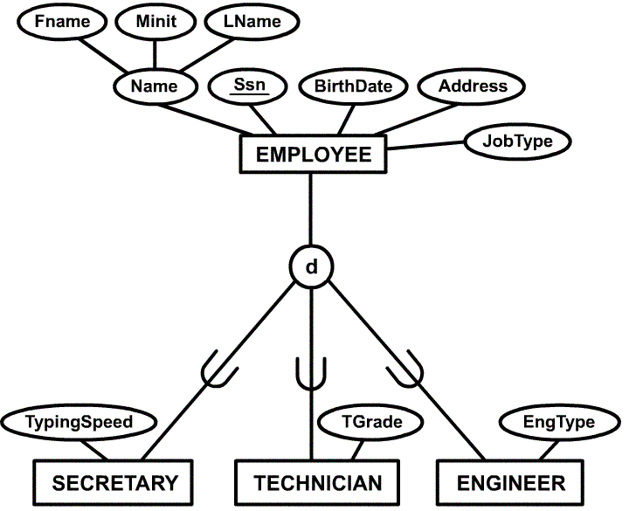
Disjoint partial Specialization
Disjoint Partial Specialization

Slide 18
Overlapping Total Specialization
“An employee MUST be a member of a Salaried as well as a Part-time”
Emp
sid
name
Generalization
o
Specialization
U
U
Salaried
Part-time

Slide 19
Specialization/Generalization Hierarchies, Lattices and Shared Subclasses
A subclass may itself have further subclasses specified on it
Forms a hierarchy or a lattice
Hierarchy has a constraint that every subclass has only one superclass (called single inheritance)
In a lattice, a subclass can be a subclass of more than one superclass (called multiple inheritance)

Slide 20
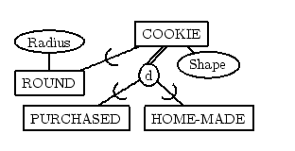
Multiple Specializations

Slide 21
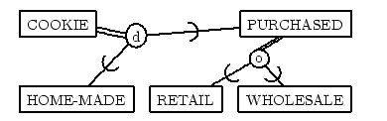
Specialization HierarchyEach subclass belongs to at most one class

Slide 22
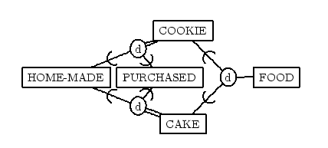
Lattice SpecializationsA subclass may belong to more than one class

Slide 23
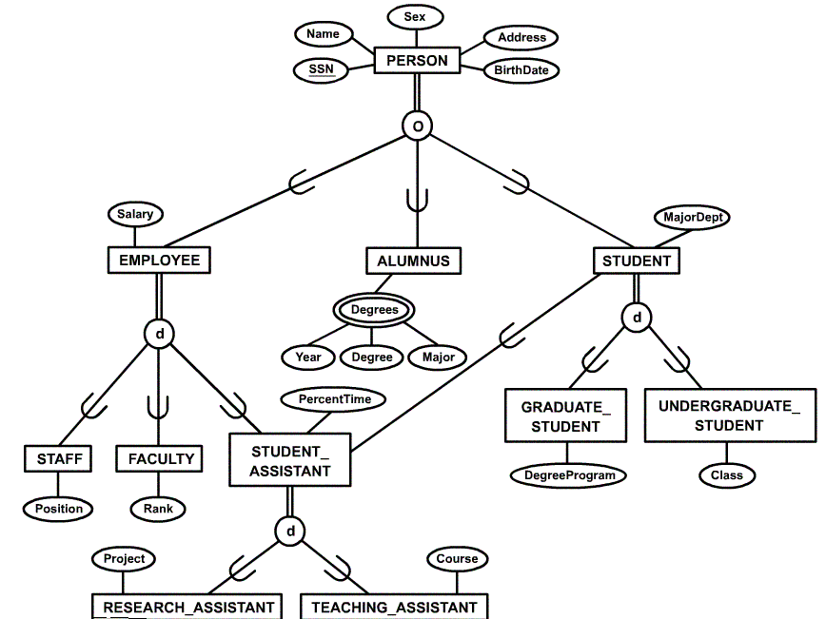
Specialization / Generalization Lattice Example (UNIVERSITY)

Slide 24
Categories (UNION TYPES)
All of the superclass/subclass relationships we have seen thus far have a single superclass
A shared subclass is subclass in more than one distinct superclass/subclass relationships, where each relationships has a single superclass (multiple inheritance)
In some cases, need to model a single superclass/subclass relationship with more than one superclass
Superclasses represent different entity types
Such a subclass is called a category or UNION TYPE
Example: Database for vehicle registration, vehicle owner can be a person, a bank (holding a lien on a vehicle) or a company.
Category (subclass) OWNER is a subset of the union of the three superclasses COMPANY, BANK, and PERSON
A category member must exist in at least one of its superclasses
Note: The difference from shared subclass, which is subset of the intersection of its superclasses (shared subclass member must exist in all of its superclasses).

Slide 25
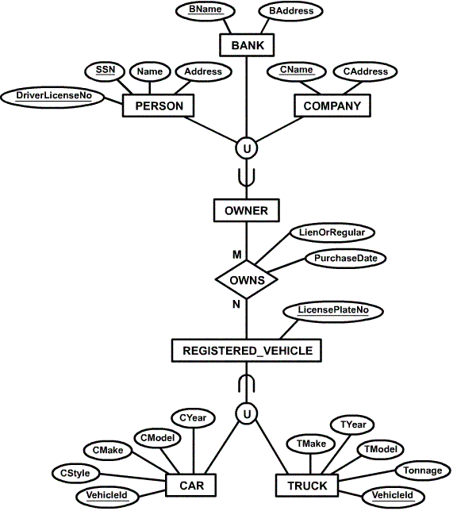
Example of categories (UNION TYPES)

Slide 26
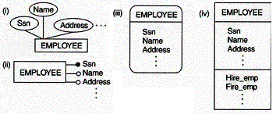

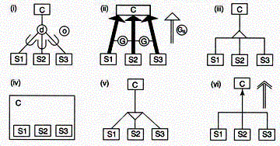
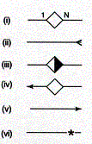
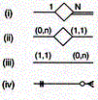
Alternative Diagrammatic Notations
Symbols for entity type / class, attribute and relationship
Displaying attributes
Notations for displaying specialization / generalization
Various (min, max) notations
Displaying cardinality ratios

Slide 27
Thankyou

